Slide 1

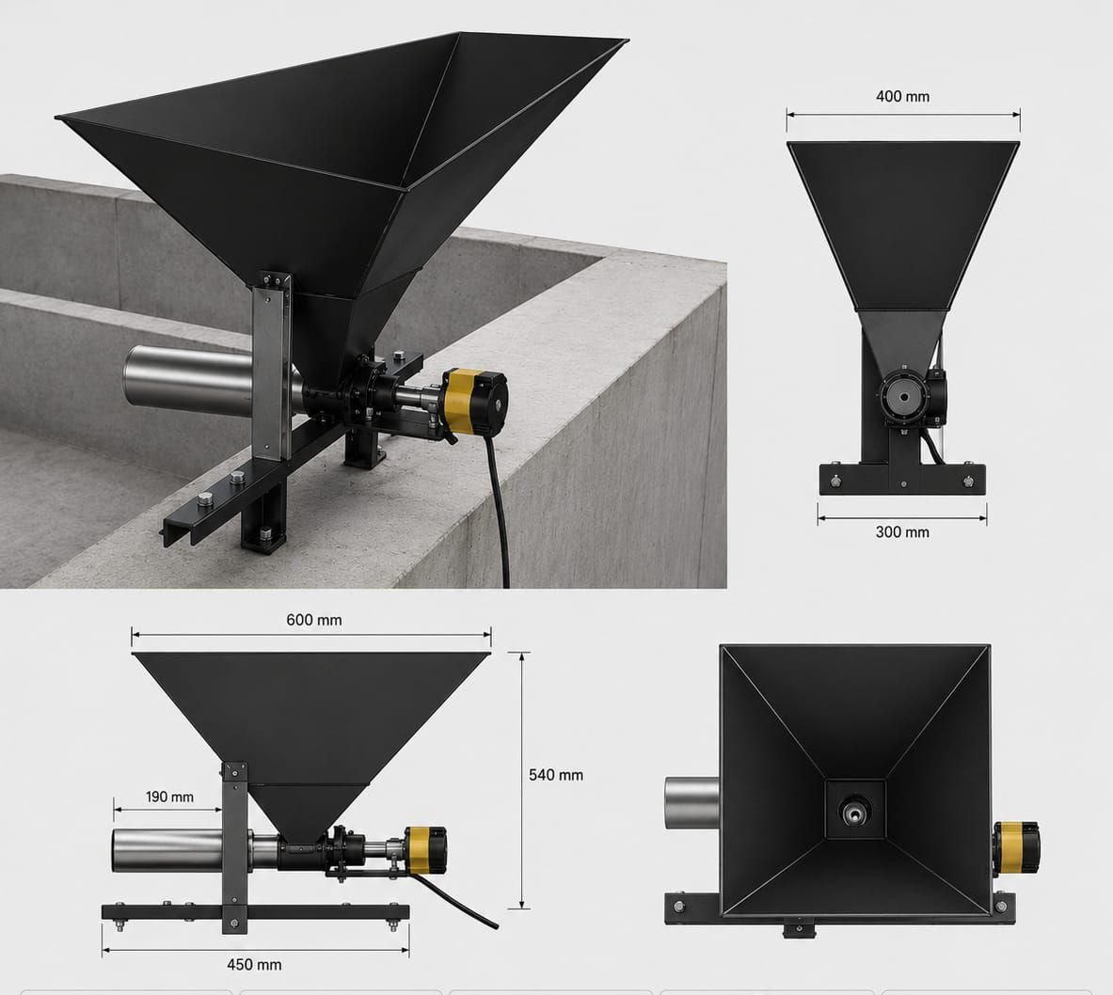
SMART
AQUA
Intelligent feeding for resilient aquaculture
SmartAqua
Africa Agri-future Innovation Challenge 2026
Ogunbunmi Philip Oluwadarasimi Federal University of Technology, Akure 08169150242 • ogunbunmiphilip@gmail.com
FIELD-TESTED PILOT

Slide 2
SMART
AQUA
WHY IT MATTERS
The aquaculture problem
Inconsistent feeding increases waste and operating cost.
Farmers cannot always be present for every feeding event.
Water-temperature changes affect fish metabolism and feed demand.
Rural farms need solutions that can become independent of unreliable grid power.
Limited farm data makes it difficult to improve feeding decisions.
The opportunity
Make feeding consistent, measurable and responsive to real farm conditions—without requiring the farmer to be physically present.
Target users: small and medium-scale African fish farms

Slide 3
SMART
AQUA
THE SOLUTION
One platform, three layers
Feeder
Intelligence
Farmer app
Motorized auger dispenser with scheduled and manual control.
Q10 temperature adjustment, feeding logs and operational sensing.
Remote control, schedules, history, alerts and device monitoring.
Current validated path
Schedule or manual request → Q10 adjustment → dispensing → experiment log

Slide 4
SMART
AQUA
PROTOTYPE IN THE FIELD
Experimental feeder design
Design characteristics
Hopper and auger-based dispensing
Stepper motor control
Designed for repeatable quantities
Mounting frame for pond-side installation
Expandable sensor and power architecture
Experimental-stage hardware shown

Slide 5
SMART
AQUA
WHAT WE MEASURED
Evidence from the pilot experiment
56 days • 224 feeding records • Manual control vs Smart Assisted
Pilot signals
+15.0% biomass gain
+29.2% average daily gain
+9.7% LER
~8.9% lower calculated FCR
Q10 factor logged across temperature changes

Slide 6
SMART
AQUA
CORE INNOVATION
Q10 makes feeding responsive
Temperature changes influence fish metabolism. SmartAqua uses a Q10 factor to adjust the requested feed quantity instead of applying one fixed amount every day.
Observed in the trial
Temperature range 23.06–27.06 °C Q10 factor range 0.866–1.165 Average dispensing deviation ≈ 1.26 g below request
Base feed quantity × Q10 adjustment factor = temperature-responsive quantity

Slide 7
SMART
AQUA
NEXT PHASE
From validated pilot to resilient platform
Now validated
Next validation
Scale pathway
Manual feeding Scheduled feeding Q10 adjustment Two-month field use
Solar + battery operation DO and pH sensing Computer-vision verification Reliability under poor connectivity
More farms and fish populations Measured labor and feed savings Deployment partnerships Commercial productization
Advanced AI, water-quality sensing and solar operation are presented as the next validation phase—not as completed outcomes.

Slide 8
SMART
AQUA
THE ASK
What support will unlock
Mentorship in aquaculture trials, product validation and commercialization.
Pilot partnerships with additional fish farms and research institutions.
Technical support for solar power, water-quality sensing and computer vision.
Access to stakeholders, investors and African aquaculture networks.
Funding to expand the field trial and quantify feed efficiency, labor savings and fish growth.
Contact
Ogunbunmi Philip Oluwadarasimi Federal University of Technology, Akure 08169150242 ogunbunmiphilip@gmail.com
SmartAqua
Intelligent feeding for climate-resilient aquaculture

